Slide 1
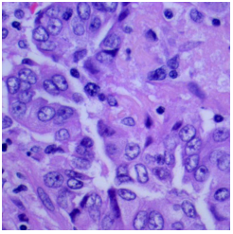
Histopathological Image
Classification
Lung and Colon Cancer Diagnosis using Histopathological Images
By
David Ross

Slide 2
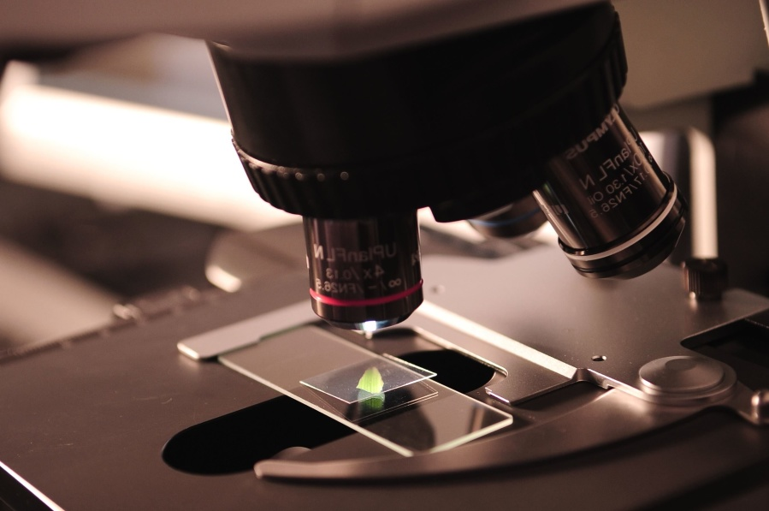
Background
Cancer Diagnosis / Tumour Identification:
Gold standard: Pathologist examines histopathological images
Automated Cancer Diagnosis / Tumour Identification:
Reduce Pathologist workload
Provide “second opinion”
Individuals/communities with limited access to healthcare services

Slide 3
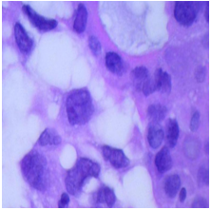
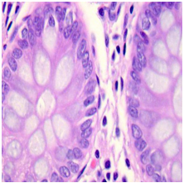
The Problem
Automate lung and colon cancer diagnosis:
Histopathological images
Tissue types:
Benign lung tissue
Lung Adenocarcinoma (ACA)
Lung Squamous Cell Carcinoma (SCC)
Benign colon tissue
Colon Adenocarcinoma (ACA)
High degree of accuracy

Slide 4
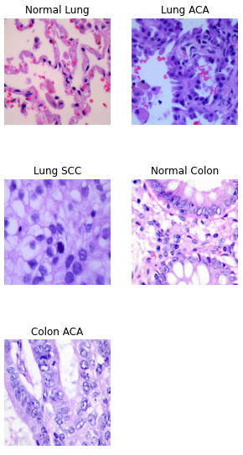
Data Collection
25,000 images - 5 classes
Normal Lung, Lung ACA, Lung SCC
Normal Colon, Colon ACA
Automated data retrieval from Kaggle
Kaggle Dataset: https://www.kaggle.com/datasets/andrewmvd/lung-and-colon-cancer-histopathological-images
Original Data Source: https://arxiv.org/abs/1912.12142v1

Slide 5
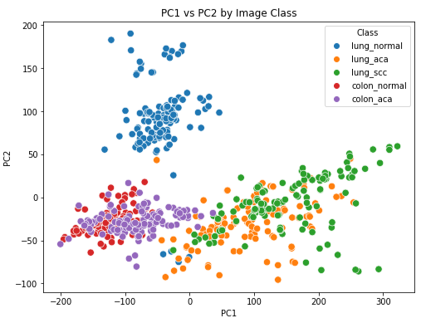
EDA - Inspect Image Class Relationships With PCA
5 classes were easily separated into 3 groups:
Benign Lung Tissue
Lung Cancer (ACA and SCC)
Colon Tissue (Benign and ACA)
Colon tissue group is most concerning. Cancer may go undetected.

Slide 6
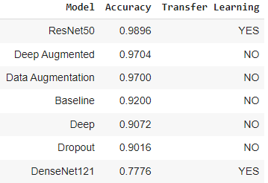
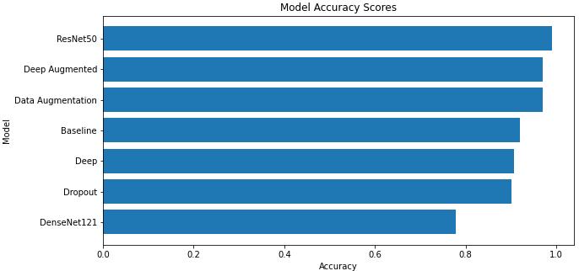
Model Selection
Tested 7 models
5 Original (non-transfer learning)
2 Transfer Learning (ImageNet weights)
Performance metric: Accuracy
Best Models:
Original: Deep Augmented Model
Transfer Learning and Overall: ResNet-50 Model

Slide 7
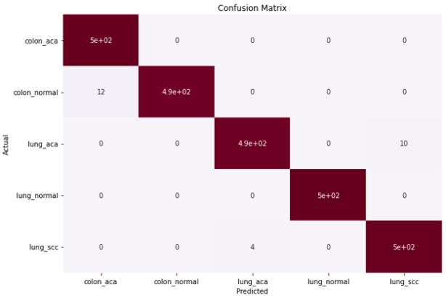
Final Model - Resnet-50 Transfer Learning Model
Performance on test data:
98.96% accuracy
100% accurate when:
Tissue is benign lung or colon ACA
Predicting benign colon or benign lung
No false negatives
Strengths/weaknesses aligned with PCA analysis

Slide 8
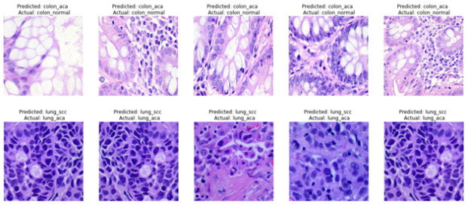
Resnet-50 Model: Problem Areas
Normal colon misclassified as colon ACA
Lung ACA misclassified as lung SCC
Trained Pathologist may have insights

Slide 9
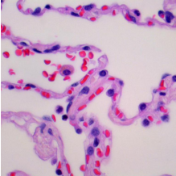

Resnet-50 Model: Feature Maps
Feature Maps were extracted for each image class
Above are sample Feature Maps for a benign lung image
Trained Pathologist may have insights
However, deep learning models tend to have poor interpretability

Slide 10


Applications
Reduce Pathologist workload
Provide “second opinion”
Screening option when healthcare services are limited
Benefits
Medical community
Patient outcomes

Slide 11

Potential Future Actions
If more computing power becomes available:
Test greater variety of model architectures
Test models on full size images
Hyperparameter tuning (learning rate, CNN kernel size, dense layer width, dropout rate, and optimizer selection)
Collect more data (raw data was augmented)
Fine tune transfer learning models
Model for each tissue type (specialization vs. less training data)
More tissue and/or cancer types
Identify tumours in images (image segmentation)

Slide 12
References
Background details (Background page): https://bmcbioinformatics.biomedcentral.com/articles/10.1186/s12859-017-1685-x
Microscope Image (Background page): https://pixnio.com/science/biology-pictures/microbiology-microscope-research-science-technology
Kaggle Dataset: https://www.kaggle.com/datasets/andrewmvd/lung-and-colon-cancer-histopathological-images
Original Data Source: https://arxiv.org/abs/1912.12142v1
Programming Image (Applications page): https://pixnio.com/objects/computer/programming-code-programmer-coding-coffee-cup-computer-copy-hands-computer-keyboard
Doctor Image (Applications Page): https://www.flickr.com/photos/30478819@N08/48719520368/sizes/z/
“What’s Next” image (Potential Future Actions page): https://www.istockphoto.com/vector/whats-next-gm1027886480-275568145

